Slide 1
Community Data Program
Catalogue, data downloading and Beyond 20/20 refresher
March 23, 2016

Slide 2
Contents
Overview / review of CDP
Communitydata.ca
Using the site
  Signing up and logging in
  Catalogue contents, geographies, Beyond 20/20, searching
Examples
  EXAMPLE #1: How do I download a dataset?
  EXAMPLE #2: How many people living alone in Calgary are divorced?
  EXAMPLE #3: How many females are low-income in a particular Calgary community?
Practice Time

Slide 3
Community Data Program (CDP)
Partnership between the Canadian Council on Social Development and Statistics Canada
Made up of 31 local consortia
Members include over 50 Canadian municipalities and over 1000 users
Facilitates community access to data from Statistics Canada and other providers

Slide 4
CDP: Purpose
Purchase and facilitate access to social data at the smallest geographies possible
Train organizations to analyze community data and use it for better decision making
Communicate and disseminate the results as widely as possible

Slide 5
Communitydata.ca
Portal for online access to CDP data
Includes links to resources and training materials
Access usually arranged within one business day when signing up
Beyond 20/20 software download available
Booking calendar for ENVISION license

Slide 6
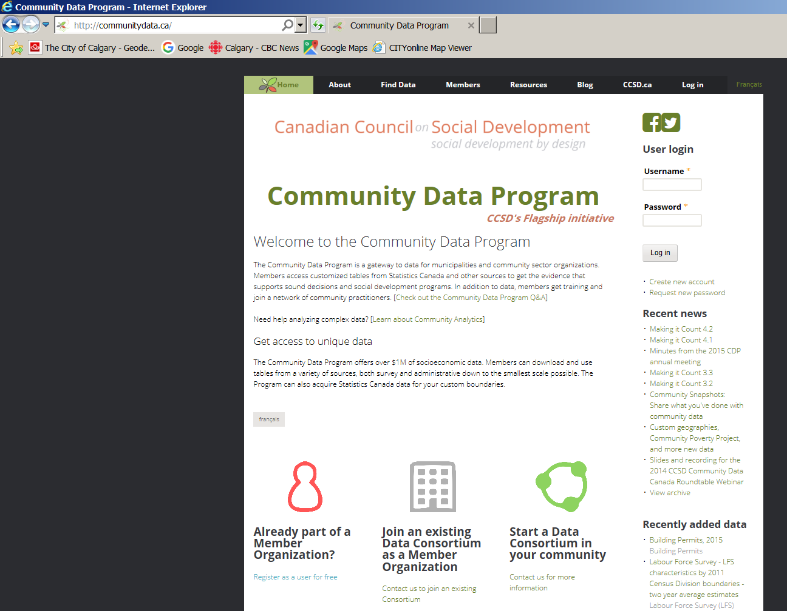
Signing up for access
Account requests are usually approved within 24 hours

Slide 7
Logging in
Please try logging in now.

Slide 8
Accessing data
Anyone can browse through the offerings under the “Find Data” tab – but you need to be a member and logged in to download datasets.

Slide 9
Catalogue contents
Small area data (e.g. Census Tracts)
Municipal level data (i.e. Calgary, Vancouver, Toronto)
Statistics Canada data at custom geographies (e.g. Calgary’s Communities)
Statistics Canada custom orders
Analysis, reporting, and visualization tools (e.g. Envision)

Slide 10
Geographies
For today’s workshop, we will use Calgary census sub-division (i.e. the Calgary city limits) and community-level data
Various standard geographies available
Custom geographies available for some products
Statistics Canada standard geographies are identified with a numeric code
Some geographies align across hierarchy and Statistics Canada provides files for each geographic family

Slide 11
Beyond 20/20 format
The majority of the data on the CDP site is in Beyond 20/20 tables, which have the extension ".ivt" (or ".ivt") at the end of the file name.
Beyond 20/20 has supported publishing of Statistics Canada data for more than 20 years. Beyond 20/20 is designed to present multidimensional data in a manner that is easy to view, easy to analyze, and easy to understand.
Beyond 20/20 files are like pivot table with all the information already in place; they help you to move dimensions around to get the view that you are interested in.
You will need Beyond 20/20 Browser software to view this data. Free download at: http://communitydata.ca/dataandcatalogueresources

Slide 12
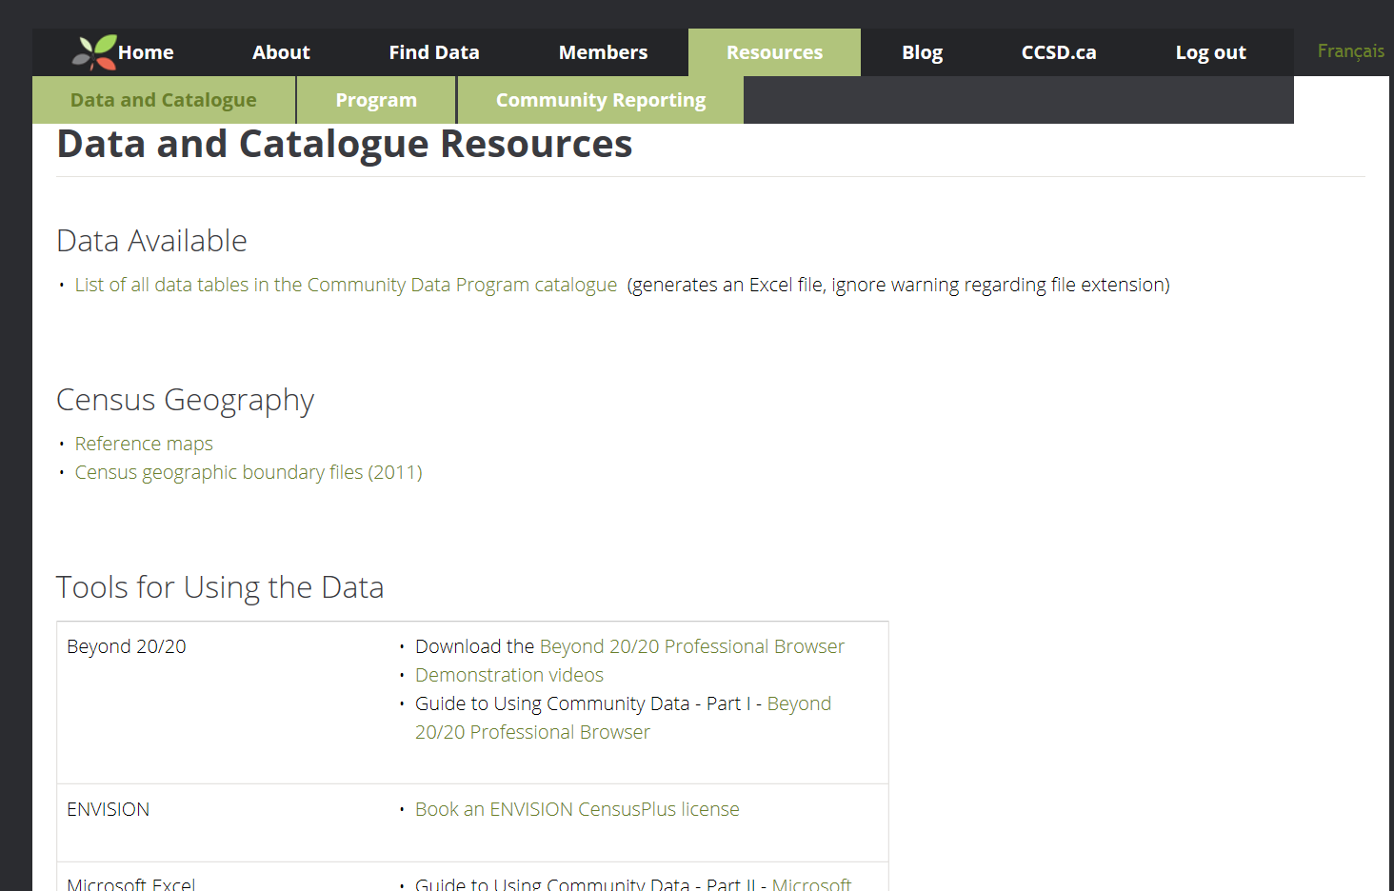
Downloading the Beyond 20/20 browser
Click on the “Resources” tab at the top > “Data and Catalogue Resources” > Download the Beyond 20/20 Professional Browser
Click “Save as” for ProBrowser.exe
Do this if you don’t have B20/20 yet; for today’s workshop, the Browser has already been installed on the computers in advance.

Slide 13
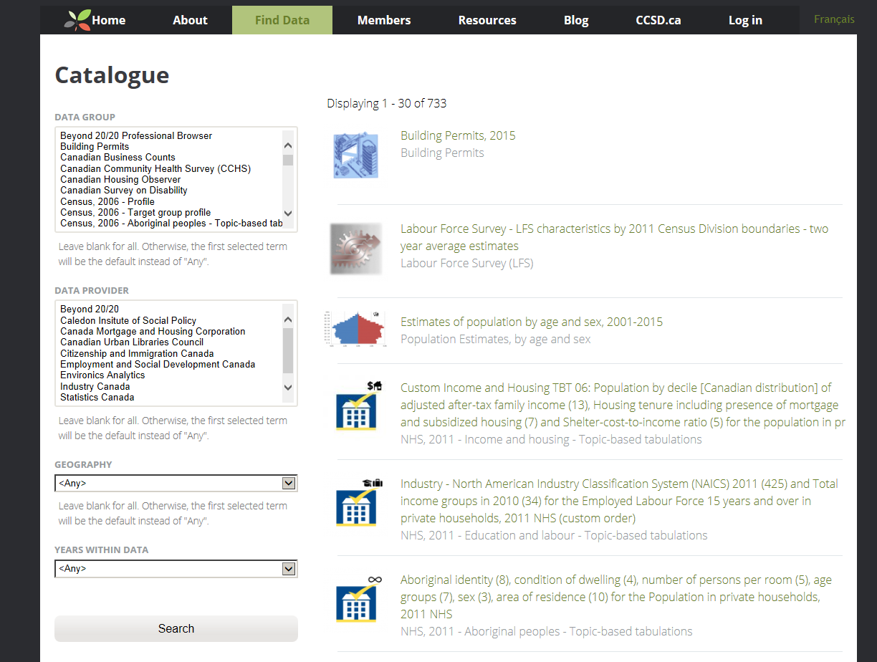
Searching the catalogue: 4 filters
Data group
(“survey”)
Data provider
Geography
Years

Slide 14
Resources
With no filters on (i.e. including all data sources), there are currently 737 products in the Catalogue.
Currently, there is no keyword search function, e.g. “health” or “Aboriginal”.
However, there is an Excel file which lists the contents of all the current datasets in the Catalogue
  “Resources” tab > “Data and Catalogue Resources” > “Data Available”
You can search for keywords within this Excel file using Ctrl+F; the Data Group for each dataset is indicated, along with the available years and geographies. Please download this file now.

Slide 15
EXAMPLE #1
How do I download a dataset?

Slide 16
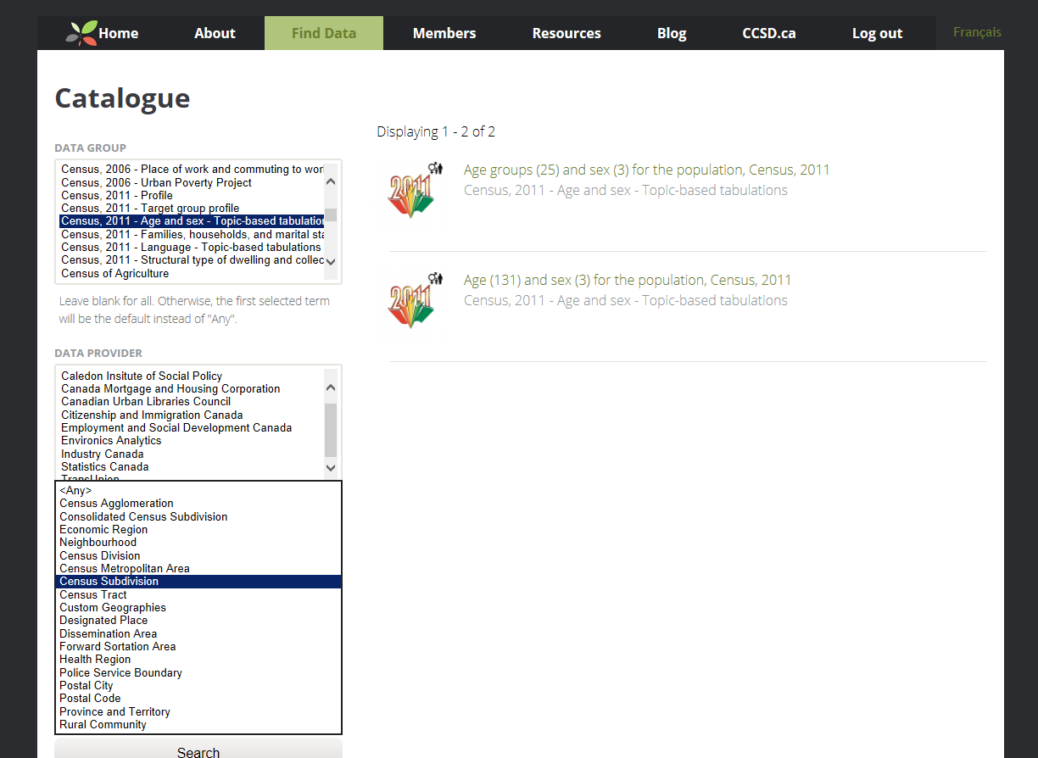
Example #1: Locate the file
Data group
“Census, 2011 – Age and sex – Topic-based tabulations”
In this example, we are assuming that we already know that the data we want is within the “Census, 2011 – Age and Sex – Topic-based Tabulations” Data Group
Geography
“Census Subdivision”

Slide 17
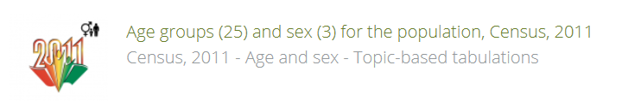
Example #1: Understanding Table Titles
Age groups (25)
Total - Age groups
0 to 14 years
0 to 4 years
5 to 9 years
10 to 14 years
15 to 24 years
15 to 19 years
20 to 24 years
25 to 34 years
25 to 29 years
30 to 34 years
35 to 44 years
35 to 39 years
40 to 44 years
45 to 54 years
45 to 49 years
50 to 54 years
55 to 64 years
55 to 59 years
60 to 64 years
65 to 79 years
65 to 69 years
70 to 74 years
75 to 79 years
80 years and over
Sex (3)
Male
Female
Total - Sex
The numbers in brackets refer to the number of items within each variable.

Slide 18
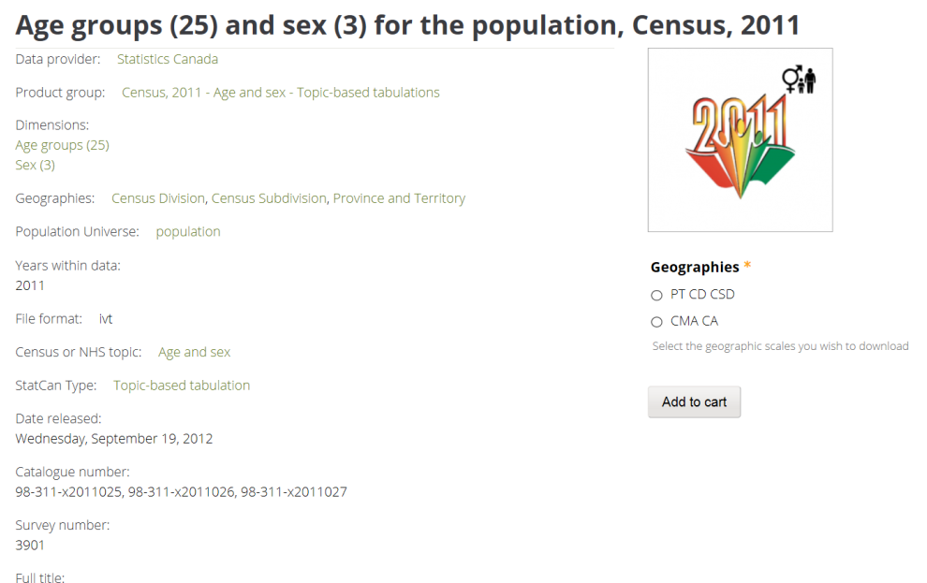
Example #1: Selecting the dataset
Click on the table name
Select the desired level of geography (for today, just select “PT CD CSD”)
Click “Add to cart”
Note that the file format is displayed on this page: .ivt means it is a Beyond 20/20 file.

Slide 19
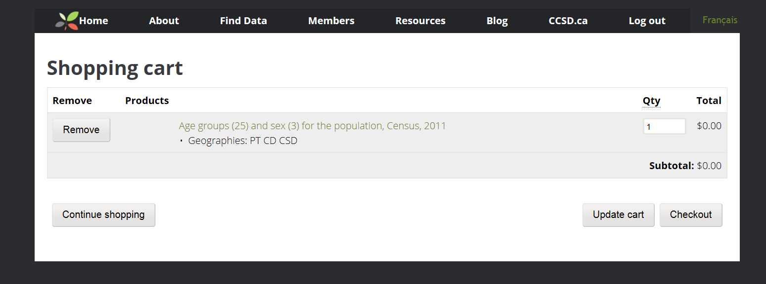
Example #1: Shopping cart
The interface looks like an online shopping site – but no charges will be incurred.
To add more items, click “Continue shopping”
To download this single item, click “Checkout”

Slide 20
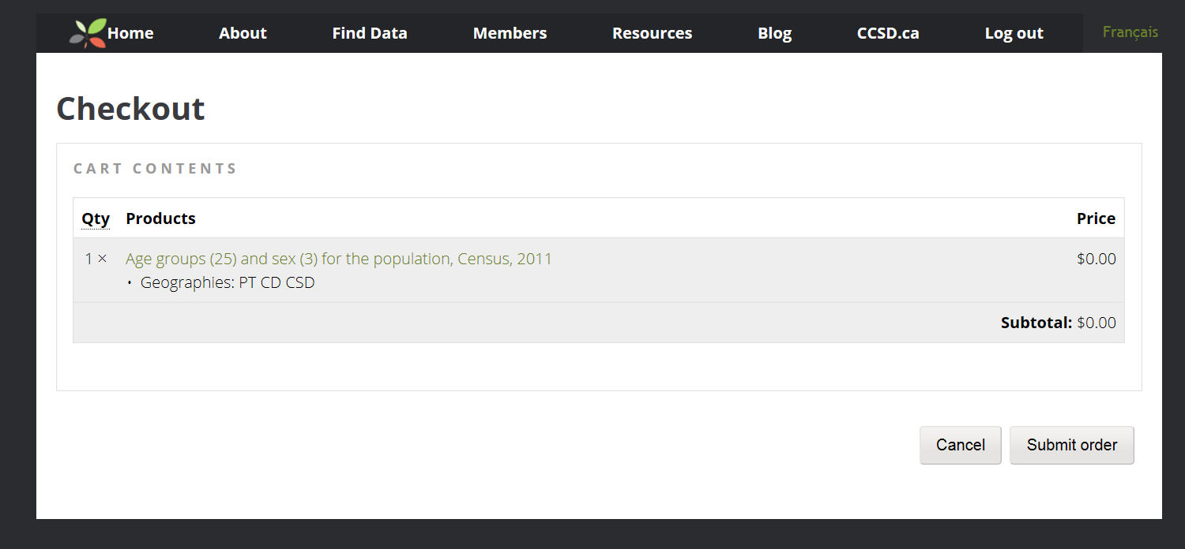
Example #1: Checkout
The dataset(s) you are downloading will be displayed once again on the “Checkout” page
Click “Submit order” to download the file

Slide 21
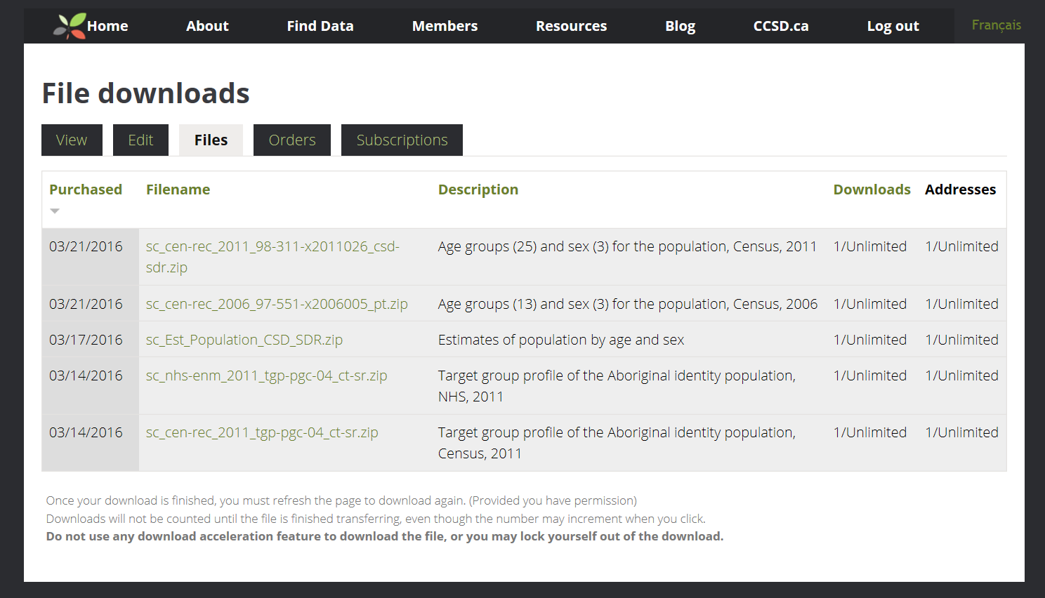
Example #1: File downloads
The file downloads page will show all the files you have ever downloaded (“Purchased”); the most recent / current file will appear at the top of the list.
Click the filename to start the download
Hint: If you type “communitydata.ca/user” into your internet browser while you are logged into the site, you can see a list of all the files you’ve previously downloaded.

Slide 22
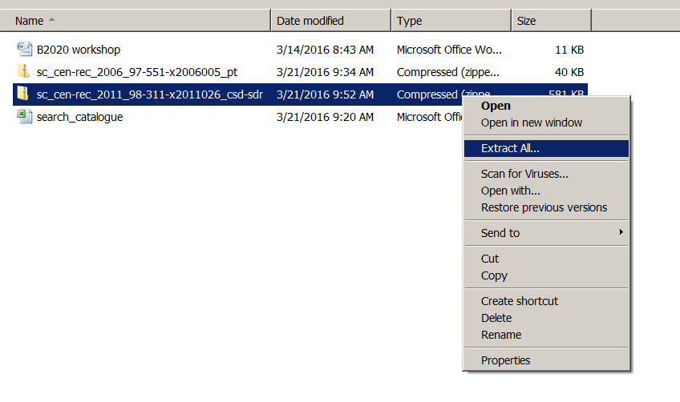
Example #1: Save and unzip the file
Note: the files will usually be in .zip format, and will have long names using several letter and number codes. If you have trouble opening the zip folder, rename the folder when saving to your computer.
When the download starts, you will be prompted to “Open” “Save” / “Save as” / “Save and open” or “Cancel”.
Save the file to the appropriate place on your local hard drive or network drive.
Navigate to the folder where you saved the file.
Double click on the zipped folder to unzip.
Congratulations! You have downloaded the dataset.

Slide 23
EXAMPLE #2
How many people living alone in Calgary are divorced?

Slide 24
Example #2: Finding the data
Step 1: What could you do to find out where data is located regarding people “living alone”?
  In the list of data tables Excel sheet, search for the word “alone” or the term “living alone”; make a note of which Data Group the table is located in
Step 2: How could you use the information from Step 1 to find the data in the Catalogue?
  Under the “Find Data” tab of Communitydata.ca, scroll down to and click on the appropriate Data Group (in this case: Census, 2011 – Target group profile)

Slide 25
Example #2: Downloading and saving data
Step 3: How would you download and save the dataset to your computer?
  Click on the first dataset in the list: “Target group profile of the population living alone, Census 2011”.
  Select the desire level of geography (PT CD CSD)
  Click “Add to Cart”
  Click “Checkout”
  Click “Submit Order”
  Click on the Filename > “Save as”
  Rename the folder with a name that makes sense to you
  Navigate to the folder where you saved your dataset
  Unzip the folder
These are the same steps we used in Example #1.

Slide 26
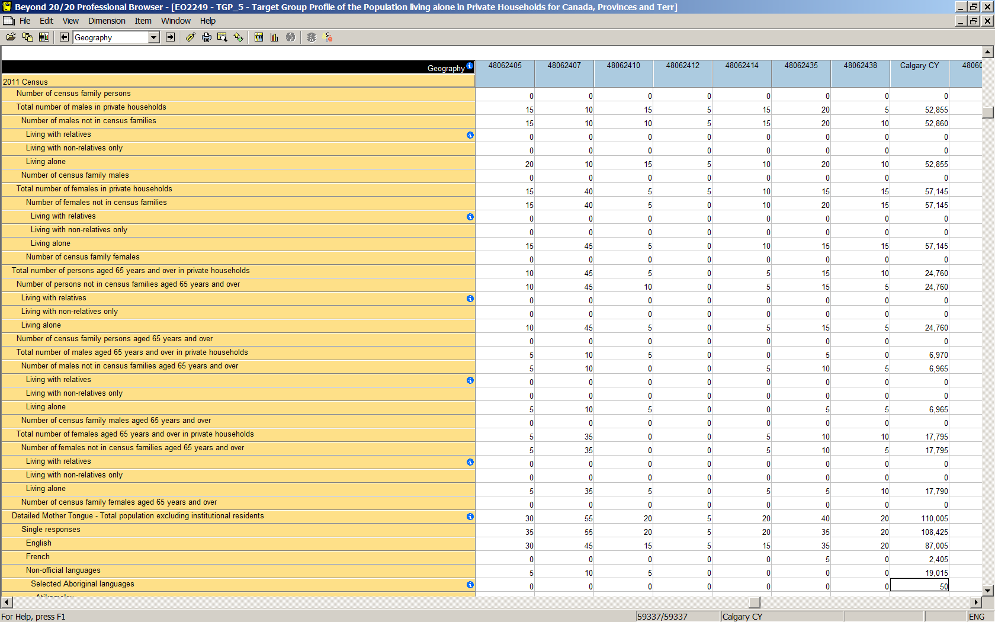
Example #2: Opening the .ivt file
Step 4: In your folder with the unzipped .ivt file, double-click on the yellow icon
Step 5: Click File > Summary to look at the metadata (notes about the dataset).
Click on the “i” symbols in the blue circles to read notes & definitions for the variables

Slide 27
Example #2: Browsing the dimensions
Step 6: Use the drop-down list at the top to browse through the dimensions. How many dimensions are there?
  In this dataset, there are only 2 dimensions: Geography, and 2011 Census.
  The numbers at the bottom of the window tell you how many items within the dimension you are currently viewing / working with.
  With the Geography dimension active, click the “Display active dimension” button. Take a look, then close the window.
  Now make the 2011 Census dimension active, and click “Display active dimension”; take a look, then close.
“59337/59337” at the bottom means we are currently viewing the data for all 59,337 geographic areas in the dataset

Slide 28

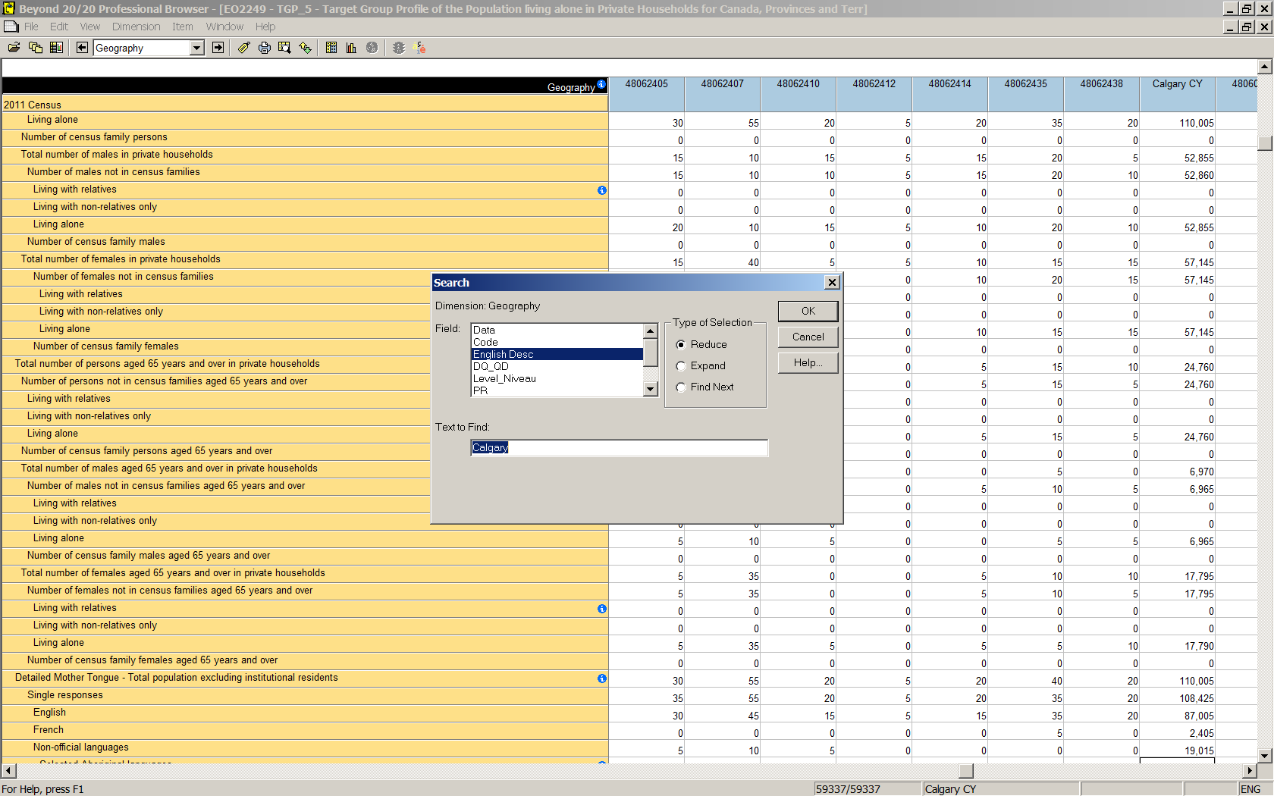
Example #2: Finding data for Calgary
Step 7: Locate the data for just Calgary.
  With the “Geography” dimension highlighted, click on “Search”
  Within the search window, click “English Desc”, and type “Calgary” in the “Text to Find” field below. Ensure “Type of selection is set to “Reduce”
  Click OK
Hint: hovering your cursor over the buttons at the top will bring up text telling you what that button does

Slide 29
Example #2: Locate data on number divorced
Step 8: Locate the rows with the “divorced” information.
  With the “2011 Census” dimension highlighted, click on “Search”
  Within the search window, click “English Desc”, and type “divorced” in the “Text to Find” field below. Ensure “Type of selection is set to “Reduce”
  Click OK
  Three rows containing “Divorced” will appear. Click on the first cell (with the value of 26,530). Then right-click on the 2011 Census dimension and select “Show All“
  Scroll down until you see the cell that is outlined in black.
  There are 26,530 people living alone in Calgary who are divorced.

Slide 30
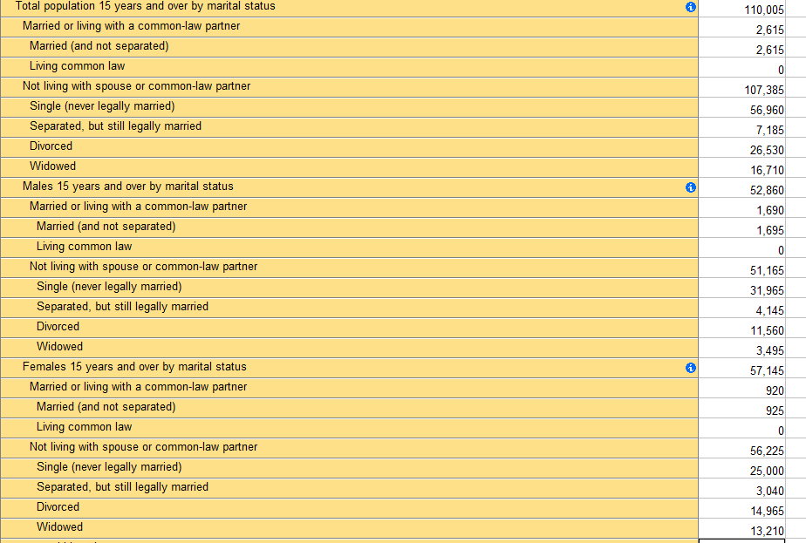
Example #2: Understanding indentation
In all the target group profiles, the characteristics are usually presented for the total population, then for males, then for females.
  So the same item (in this case, re: marital status) appear three times.
  Indented characteristics are sub-sets of the characteristic above (i.e. “male” is a sub-set of “total population”).
Total
Single, Separated, Divorced and Widowed are a breakdown within the category of “Not living with spouse or common-law partner”
Males
Females

Slide 31
Example #2: Copying into Excel
Step 9: Let’s assume we’re interested in making a chart about the numbers of the total population living alone
  Click on the cell that says “Total population 15 years and over by marital status”
  While holding down your mouse, drag down to “Widowed”, then drag right one column to where the numbers are, and let go of your mouse button.
  Right-click, and select “Copy”
  Open Excel, and left-click “Paste” (or CTRL+V).
  The highlighted cells, plus the dimension headings are now in an excel chart; indenting is preserved.

Slide 32
EXAMPLE #3
How many females in a particular Calgary community are in low-income (LIM-AT)?

Slide 33
Example #3: Preliminary steps
Step 1: Go to communitydata.ca, click the “Find Data” tab, and filter by “Geography” > “Custom Geographies”
  Click “Search,” on the left side of the page near the bottom
  Search within the results (Ctrl+F) for “CPP Table 1”
Step 2: Download the “Custom goes” file, save the file, and unzip
Step 3: Open the table in Beyond 20/20
Step 4: Browse the dimensions

Slide 34
Example #3: Find data for Calgary communities
Step 5: Locate the records for Calgary communities
  With the “Geography” dimension highlighted, click on “Search”
  Within the search window, click “English Desc”, and type “CAL - COM” in the “Text to Find” field below. Ensure “Type of selection is set to “Reduce”
  Click OK
  You should see that now 195 of 3696 geography items are being displayed

Slide 35
Example #3: Find data for Calgary communities
Step 6: Locate the record for a particular community
  With the “Geography” dimension highlighted, click on “Search”
  Within the search window, click “English Desc”, and type the community name in the “Text to Find” field below. Ensure “Type of selection is set to “Reduce”; click OK
  For this example, we will use the Calgary community “Beltline”

Slide 36
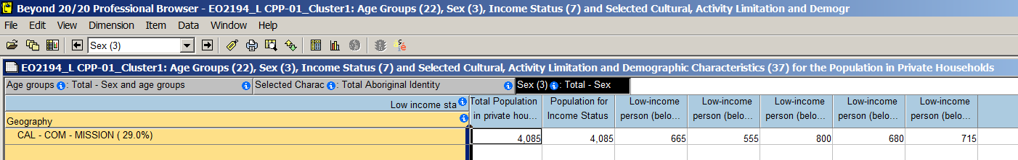
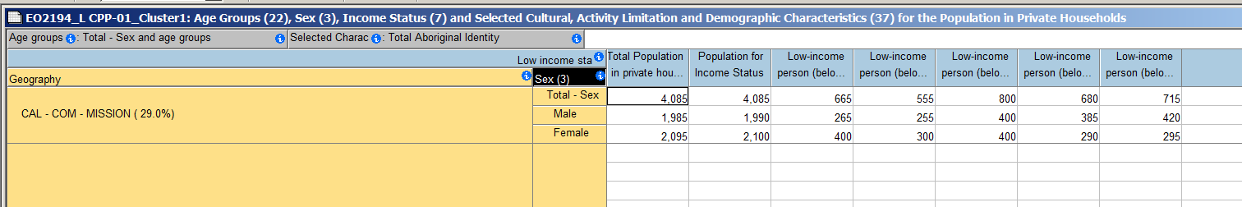
Example #3: Find data for Calgary communities
Step 7: Flip dimensions
  Your selected community should now be displayed along the side, and the “Low income status” dimension is across the top
  We want to know how many FEMALES are in low income in the community
  Click and drag the “Sex” dimension” to the left of your community name cell – a dark blue line will appear; let go of your mouse button
  You now have the low-income characteristics broken down by sex

Slide 37
Example #3: Experiment with dimensions
Take some time to experiment with dragging and dropping dimensions
  How many male immigrants are low-income after-tax (LIM-AT)?
  How many people (Total – Sex) had a different address 5 years ago and are low-income after tax (LIM-AT)?

Slide 38
Example #2: Saving as an Excel file
Step 8: An alternative to copying and pasting is to save the whole profile as an Excel file
  Click File > Save As
  In the “List Files of Type” drop-down box select “Excel Worksheet (*.xls)”
  Under the Directories tree, navigate to where you want to save your Excel file.
  Click OK.
Note: In general, it is best to keep your original .ivt file as-is instead of saving a new version of it. That way, you can come back to all the original data later. If you hide items and then re-save the .ivt, you won’t be able to view those hidden items when you re-open the file.

Slide 39
For all projects, remember:
Check GNR for all geographies you are using for analysis
Check definitions of all items in Beyond 20/20 to ensure the meaning is consistent with your understanding
Refer to the Census and NHS dictionaries to clarify definitions if necessary
Review technical reports and other documentation provided by Statistics Canada if available

Slide 40
Thank you!
Jasmine Ing
Research Social Planner
City of Calgary
403-268-5472 | jasmine.ing@calgary.ca

